Slide 1
A day in P1

Slide 2
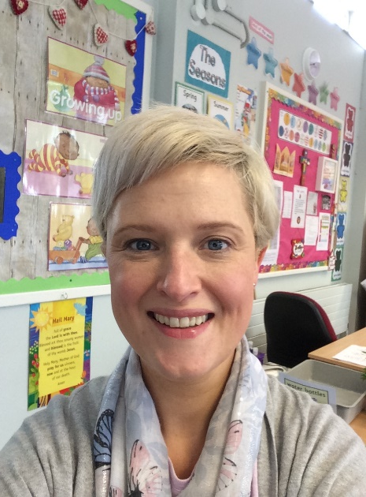
Welcome to P1.
My name is Mrs Doherty and I will be your new teacher.
Let me tell you what a day in P1 looks like.

Slide 3
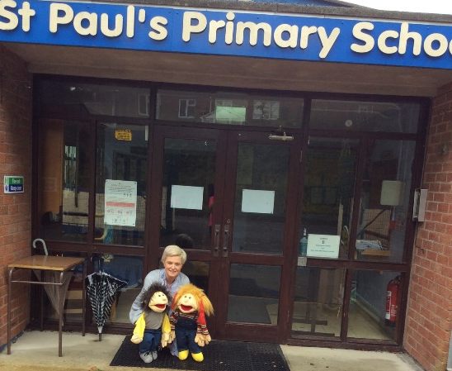
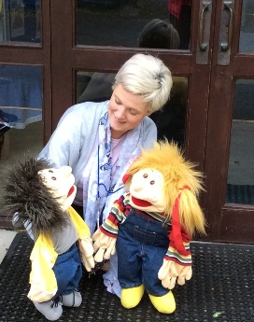
Good morning!
When you come to school in the morning, you need to walk from the car park to the front door of our school.
I will be there to see you and talk to you and your grown-ups. You might see some adults who work in our class too.
You will say “Bye bye” to your grown ups and come into school. Don’t worry, you will see them again very soon.
P1 children arrive to school at 9.45am
Insert a photo showing where

Slide 4
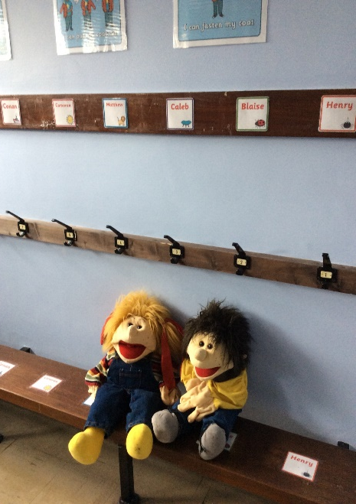
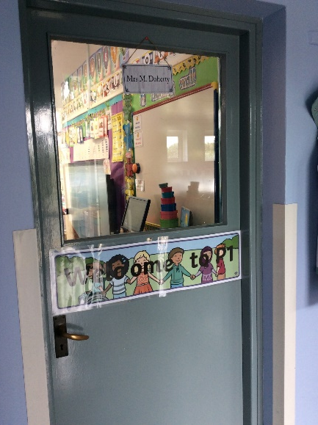
When you come down the corridor, you will need to take off your coat and hang it on your peg. Each child in our class has their own peg.
You will bring your lunch box into class and leave it on the bench.
Your wellies go on the floor underneath the bench.

Slide 5
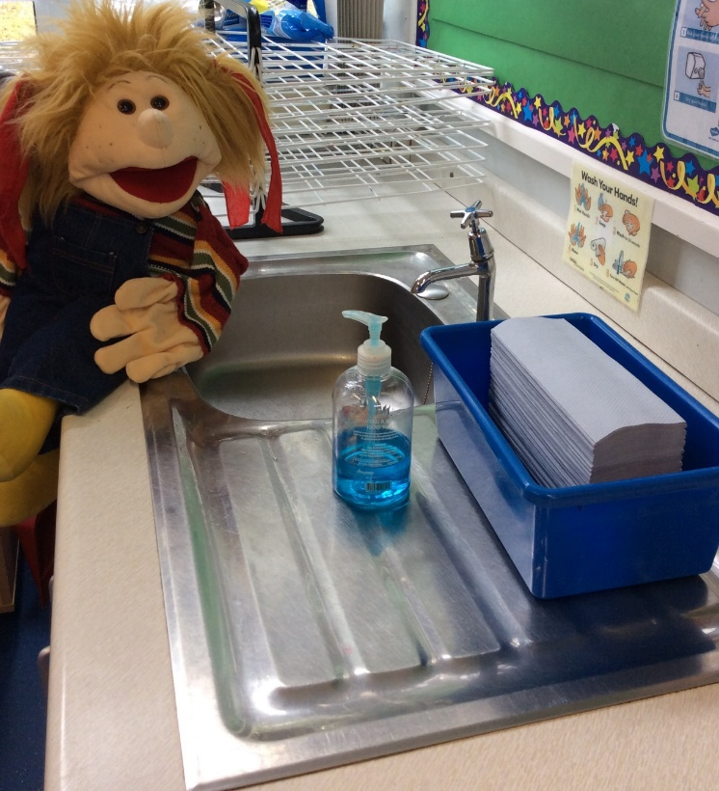
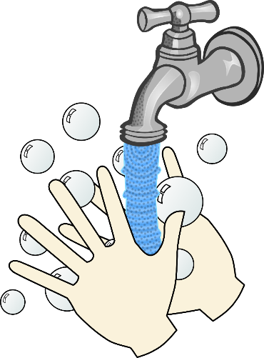
The first thing we do when we come into the P1 Class is…
wash our hands
wet your hands
take some soap
wash them carefully for 20 seconds
take a paper towel to dry them
put the paper towel in the bin

Slide 6
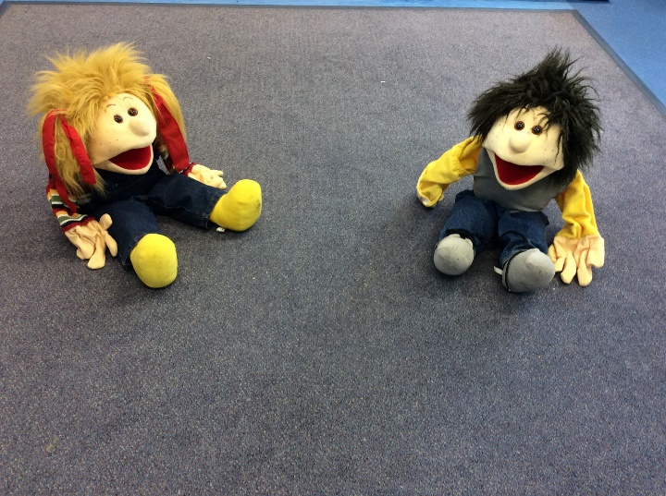
Our next job is to do the register. We sit quietly on the carpet for this special job. I will read out a list of all the children in our class to see who is in school today.
I will also ask you if you are having a packed lunch or a school dinner. The we say our morning prayer.
Insert a photo of yourself here.
School Dinner cost £2.60 a day or £13 a month.
Dinner money should be in a sealed envelope with your child’s name and class clearly marked on it.
Dinner money is paid in advance please on the first school day of the week (usually Monday).
The children leave their envelopes in a basket at the office on their way into school.
Insert a photo of register time.

Slide 7
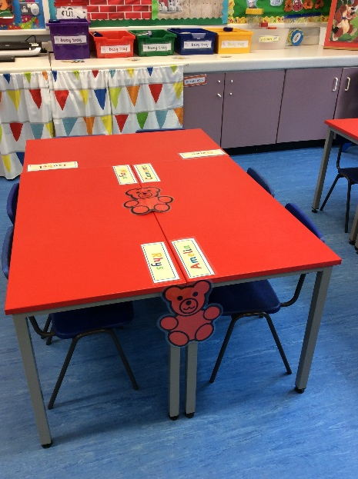
We will have a talk about what we will be doing for the rest of the day.
You will be in a ‘teddy group’. Each teddy group will sit and play together.
Insert a photo which shows you in the classroom.
Insert a photo of yourself here.

Slide 8
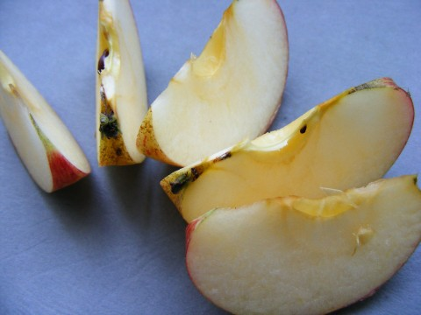
Snack time After our morning learning time, we will wash our hands and get ready for snack. You will need to bring a ‘ready to eat’ healthy snack from home. Grown ups, please remember that we are a NUT FREE SCHOOL. Also, please ensure that grapes are cut in half lengthways.

Slide 9
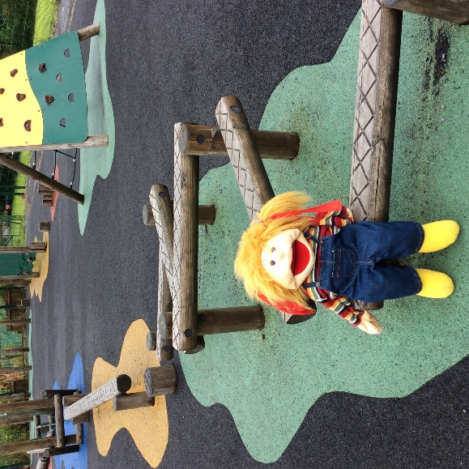
During the day, we go outside to the playground to play.
Each class will take turns to play on the playpark, play football and the playground.
Sometimes the P1 children get to use the bikes! It is great fun!
Insert a photo which shows the playground.
Insert a photo of yourself here.

Slide 10
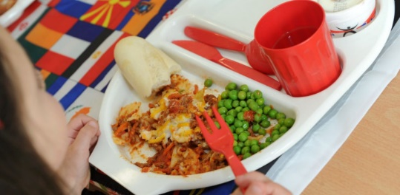
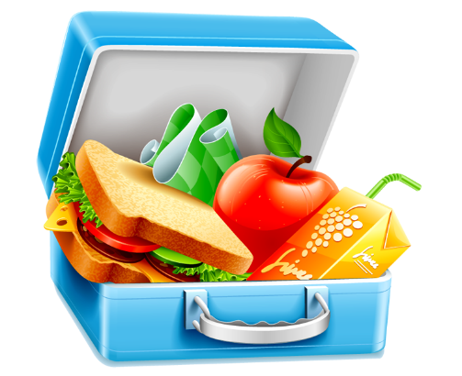
After our morning play time, it is lunchtime.
There are lots of people to help you at lunchtime.
We will be eating our packed lunches or school dinners in our classroom. After that we will go outside to play. Sometimes it is too wet to go outside and we stay indoors.
Insert a photo of yourself here.

Slide 11
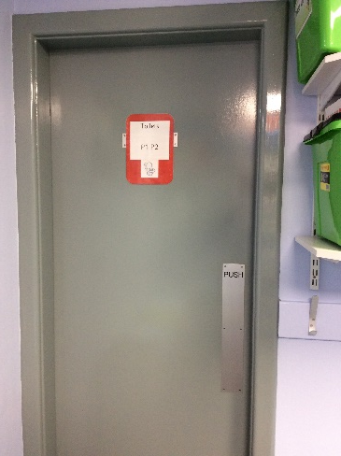
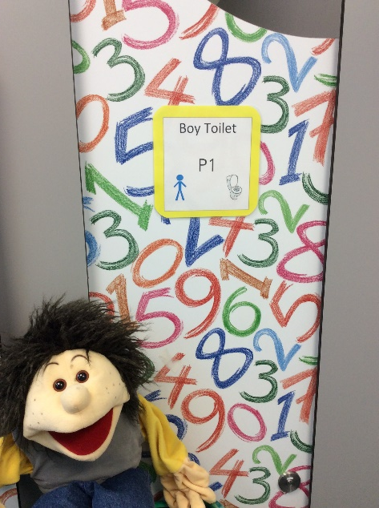
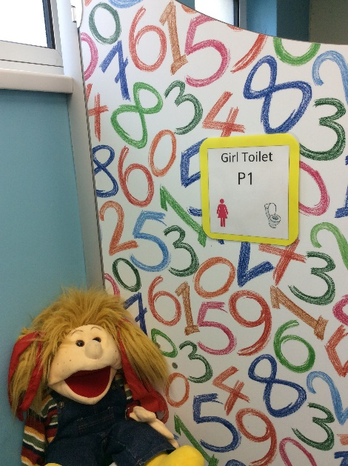
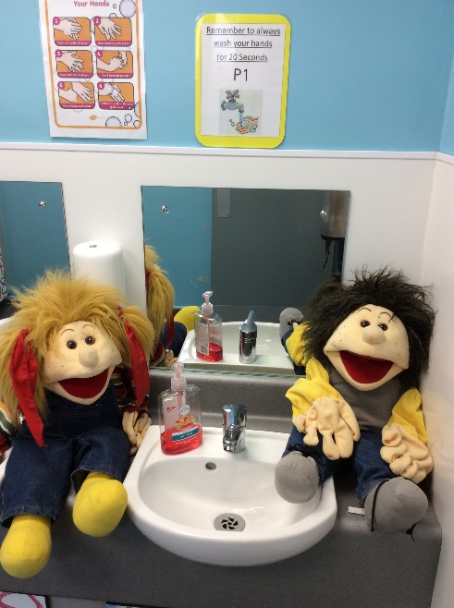
Where is the bathroom?
A grown up from your class bubble will take you down the corridor to the bathroom and wait for you to come out. The P1 girls and boys have their own toilets and sink.
Pam and Sid were very brave and washed their hands very well!

Slide 12
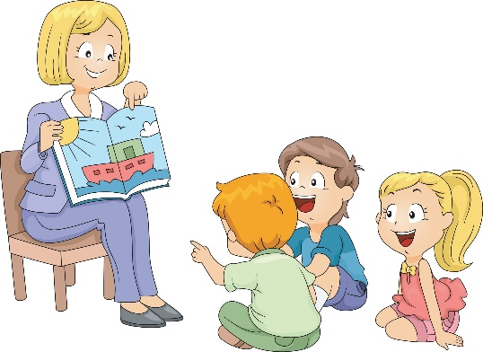
After lunch, we will wash our hands and then do the afternoon register. We get ready for our afternoon learning time.
Insert a photo of song time.
Insert a photo of yourself here.

Slide 13
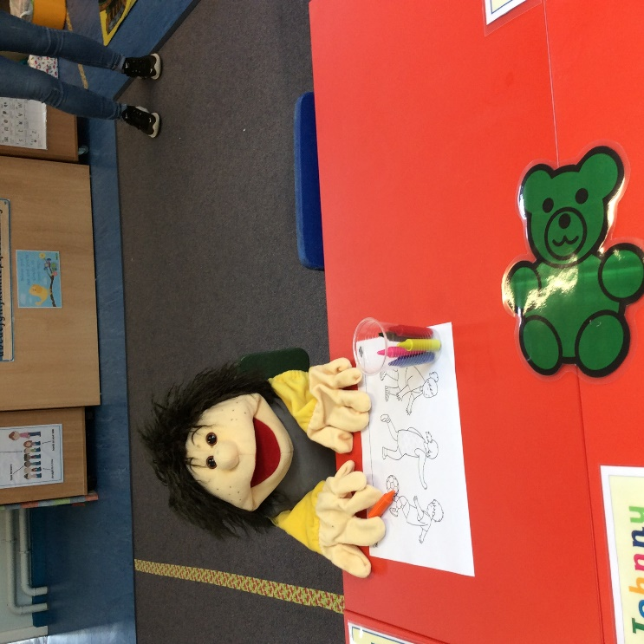
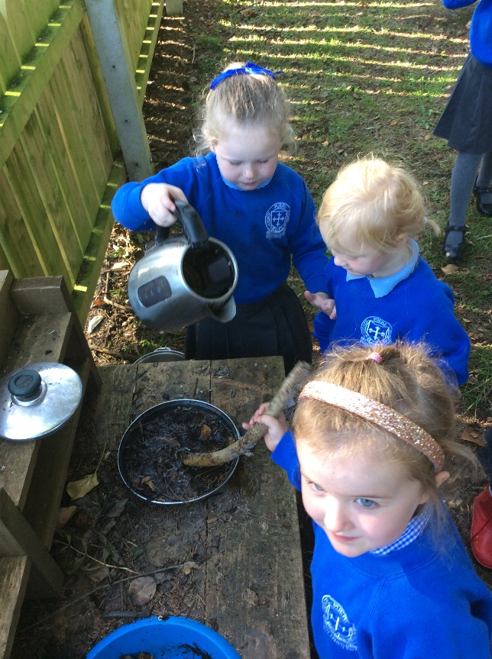
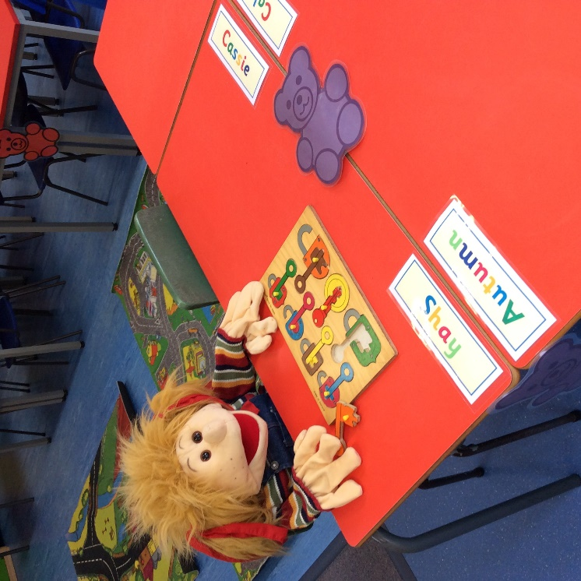
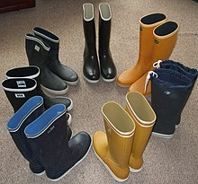
Insert a photo of yourself here.
Then, it’s time for some more learning fun! Sometimes we will put our wellies on to go outside.

Slide 14
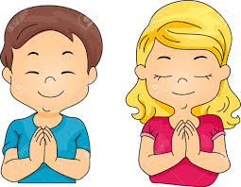
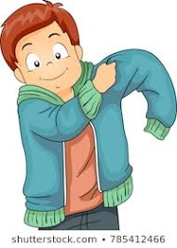
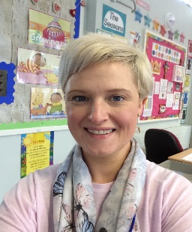
Just before it is time to go home, we sit together on the carpet and talk about all the fun things we did today.
We sometimes have a story or sing some songs too.
We say our end of the day prayer, and get ready to go home.
Insert a photo which shows story time.
Insert a photo of yourself here.

Slide 15
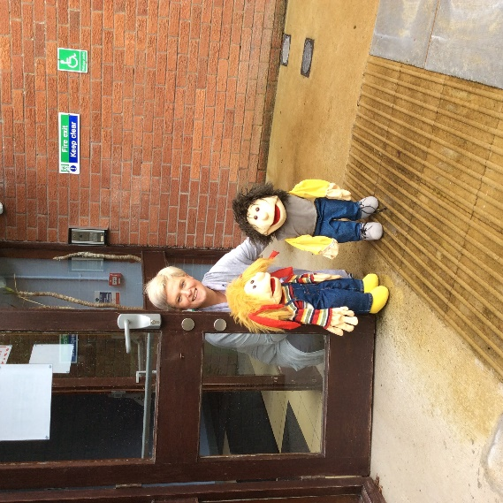
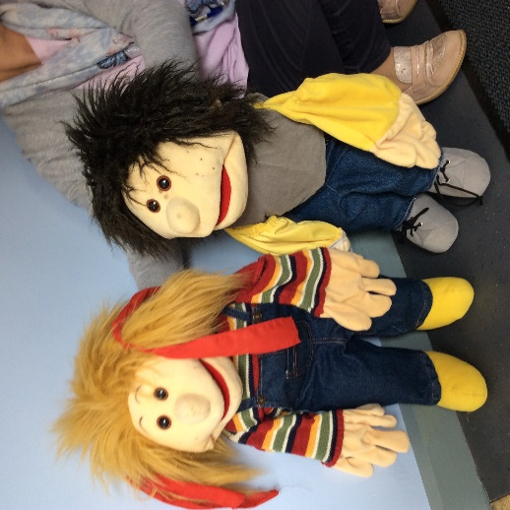
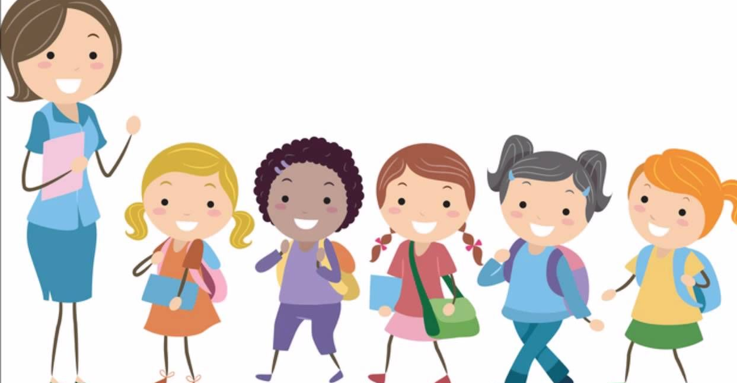
When it is home time, we put on our coats and line up on the corridor. I will take you to the Irvinestown door where your grown ups will be waiting for you. The children wait to be called to the door so that Teacher can keep everyone safe.
When you have settled into school, we will walk you to the carpark where your grown ups will be waiting to take you home.
P1 Home time is 1.50 pm
Insert a photo of yourself here.

Slide 16
We are really looking forward to meeting you all again next Tuesday. Until then, you can help your grown ups get all your school things ready.
your uniform
coat
wellies
colouring pencils, crayons or twistables in a pencil case which will stay in school
a water bottle with your name on it (this is brought home daily)
your morning snack and your lunch box
GROWN UPS, PLEASE MAKE SURE YOUR CHILD’S NAME IS ON ALL THEIR THINGS. (CLOTHES, SHOES, STATIONARY, COAT, LUNCH BOX, WELLIES ETC). WE WANT EACH CHILD TO USE ONLY THEIR OWN BELONGINGS.

