Slide 1
P1 June Homelearning
UP UP AND AWAY!
Hello/
Overview/ Play and World Around Us Activities

Slide 2
June P1 learning overview
This is an overview of the work that would be completed under normal circumstances in school. I have included lots of practical activities. Please pick from it as you wish.

Slide 3
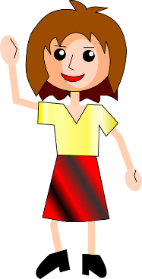
Hello girls and boys,
It is hard to believe that we have nearly reached the end of your P1 year! I really wish things were different for you and that we were in our classroom learning, exploring, having fun and sharing stories together. Although your P1 year hasn’t turned out the way we had planned, I hope that you have been enjoying the sunny weather and having fun.
We are so very proud of our wonderful P1 children in St. Paul’s. We think you are all super stars. Mrs Cassidy, Mrs Maguire and myself miss you all very much.
If you have done something you would like to show me, your grown ups can send me an email. I really enjoy hearing from you!
If I can help in any way please get in touch.
Keep safe and have fun,
Mrs Doherty x

Slide 4
Let’s Play!
Roleplay in the Travel Agents.
Our June pretend play focuses on the Travel Agents. We
look at maps
Find out about other countries
talk about pretend holiday plans.
write tickets
Look at pictures of different types of holidays (photo packs on Twinkl)
Think about what we would pack for a holiday
There are lots of lovely travel agent resources on the Twinkl Website. Type in Travel Agent EYFS into the search bar.

Slide 5
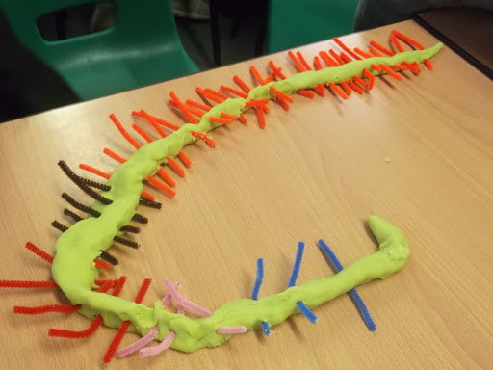
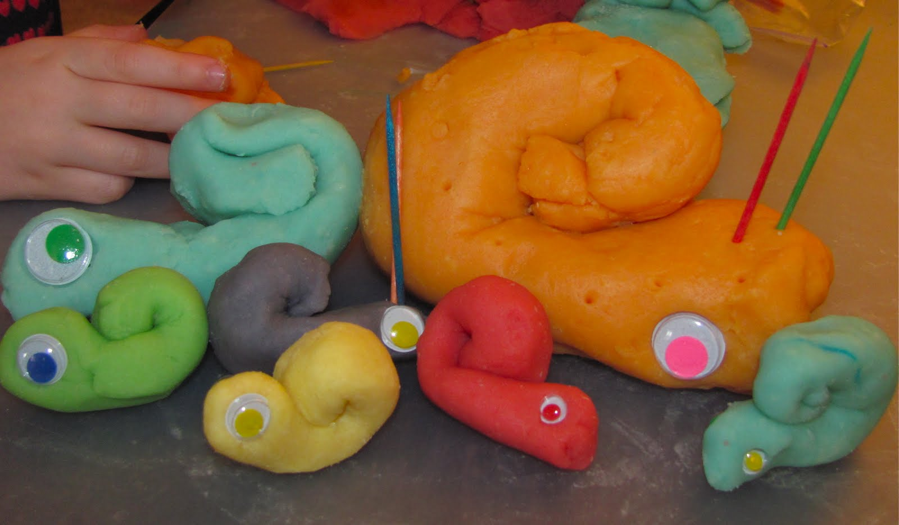
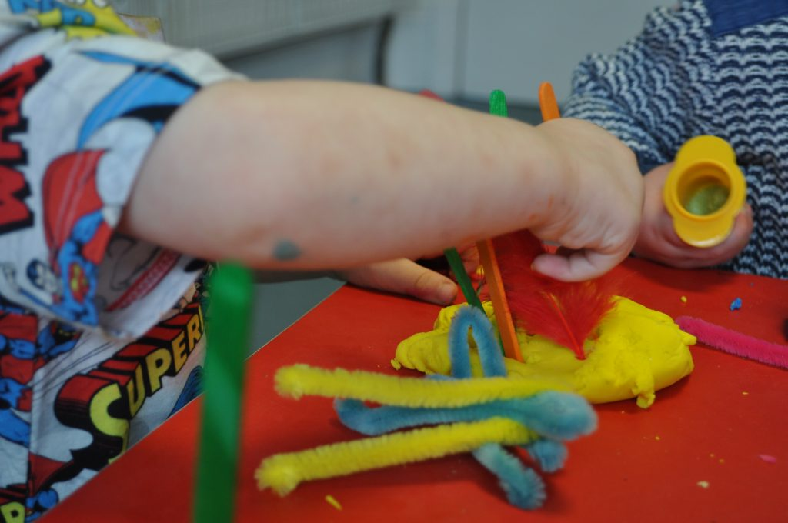
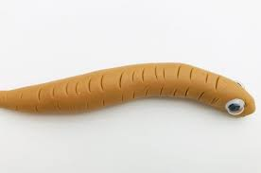
Playdough
Look closely at minibeasts in your garden or at photographs. What can you see? Can you count the legs, eyes or antennae?
Can you roll your play dough into a sausage shape or a ball to make a bug of your own?

Slide 6
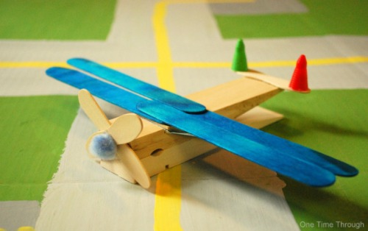
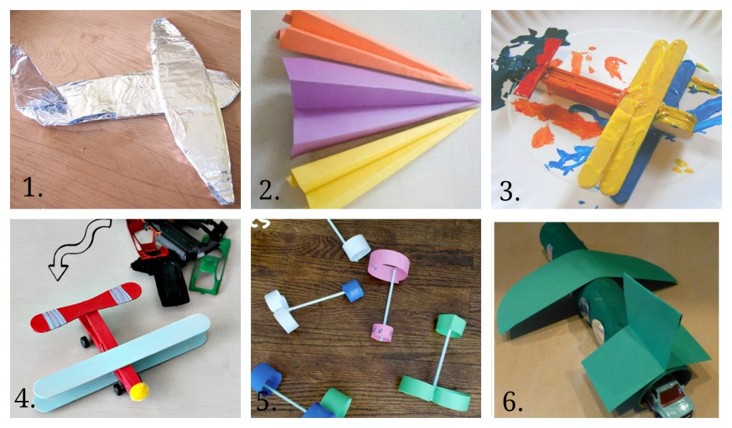
Small world Play: Airport
Can you create your own pretend airport? Maybe you have some airport toys at home? If not, you could make some aeroplanes out of things you have at home. Look at airport photos for ideas. Paper planes are great fun too!
Here is a lovely airport cartoon…
https://www.youtube.com/watch?v=IESU1vfQxkk

Slide 7
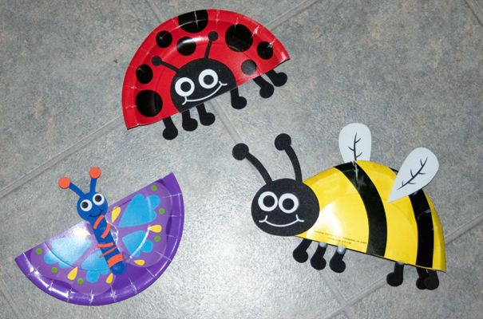
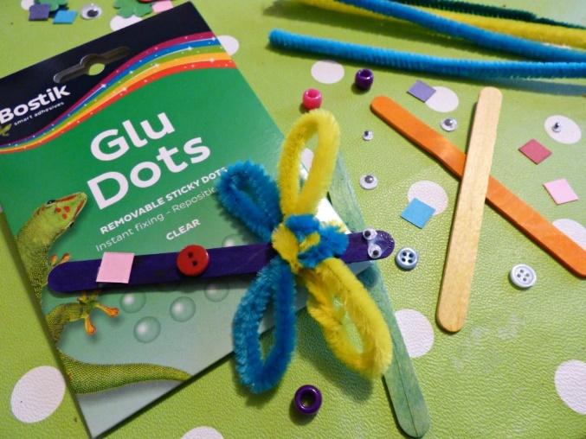
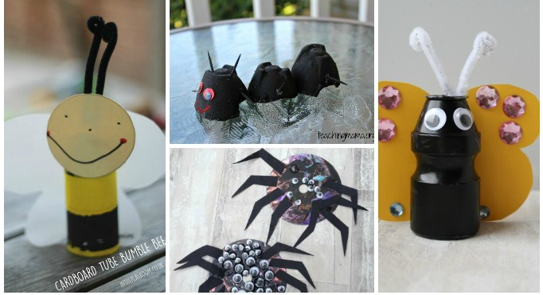
Art and craft – making flying insects. Summer paintings.
https://www.twinkl.co.uk/resource/t-t-18828-incy-wincy-spider-prop
-craft-instructions-powerpoint
https://www.twinkl.co.uk/resource/t-t-18819-fingerprint-minibeast-garden-craft-instructions-powerpoint

Slide 8
Can you create a summer painting?
A beach scene?
The beautiful sea side?
A summer sky?

Slide 9
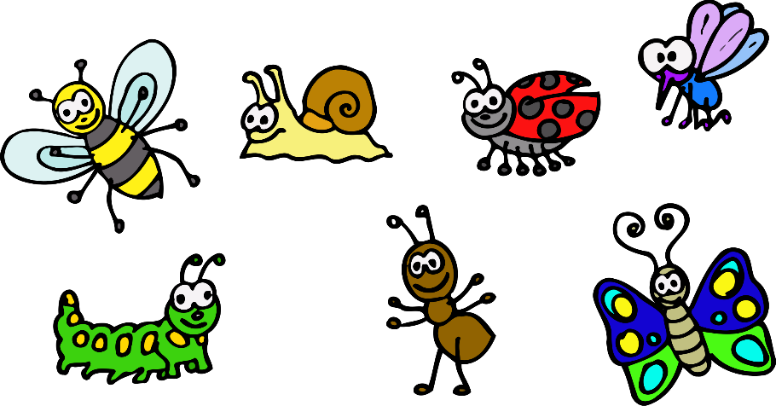
Gardening Week
Fermanagh and Omagh District Council is celebrating National Gardening Week by giving away a free packet of wildflower seeds to families who want to grow a bee bed and help wildlife in their garden.
To register for your free packet of seeds please click on this link, https://form.jotform.com/201172565524047 to complete the request form.

Slide 12
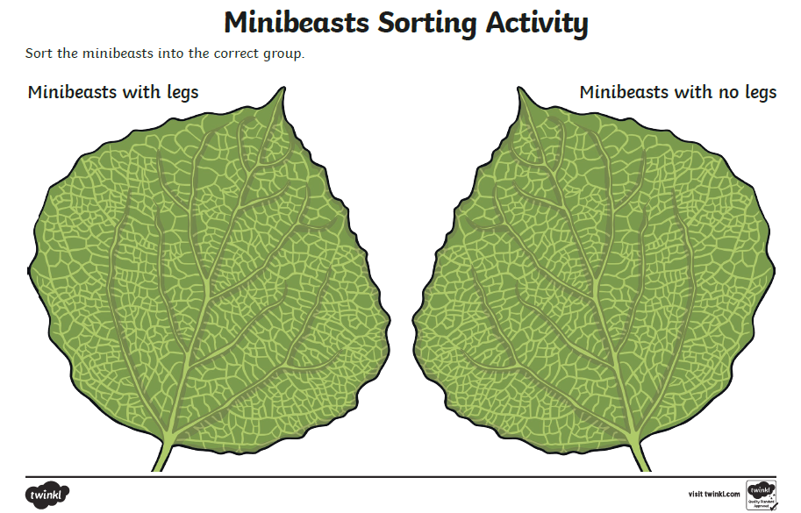
Minibeasts. Can you sort out the minibeasts on the next slide? You will need to group all the mini beasts that have legs and the minibeasts that don’t.

Slide 14
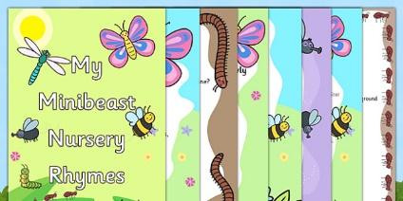
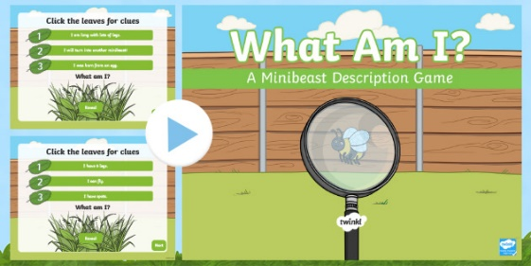
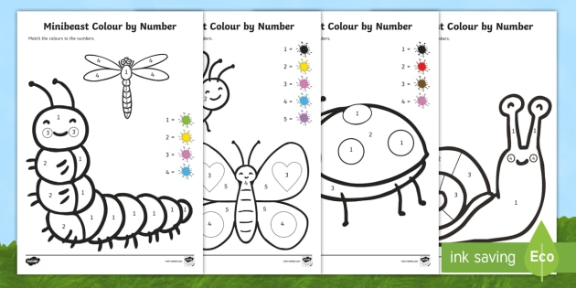
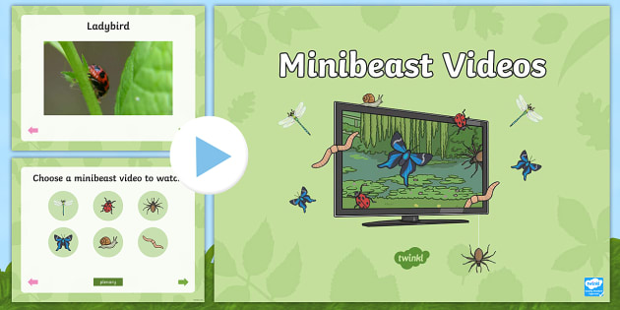
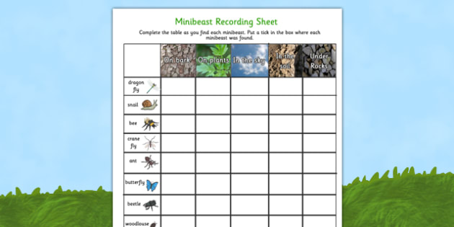
https://www.twinkl.co.uk/resource/t-t-5116-minibeast
-nursery-rhyme-booklet-pack
https://www.twinkl.co.uk/resource/t-t-5145-minibeasts-what-am-i-interactive-powerpoint-game
https://www.twinkl.co.uk/resource/eyfs-minibeasts-colour-by-number-activity-sheets-t-tp-6929
https://www.twinkl.co.uk/resource/t-t-5144-minibeasts-videos-powerpoint
https://www.twinkl.co.uk/resource/t-t-10218-minibeast-hunt-and-location-recording-sheet

Slide 15
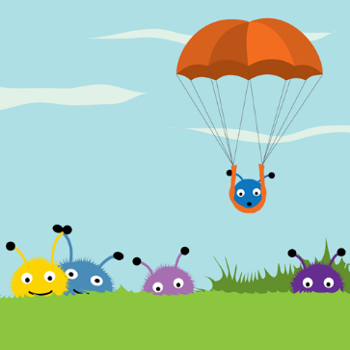
Can you make your own parachute?

