Slide 1
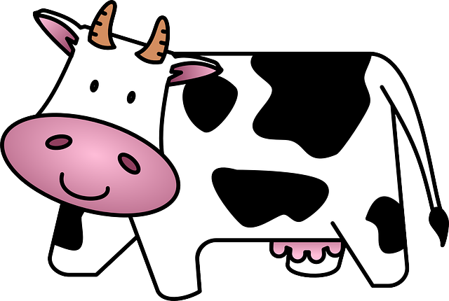
Daisy and Teacher Make Playdough!

Slide 2
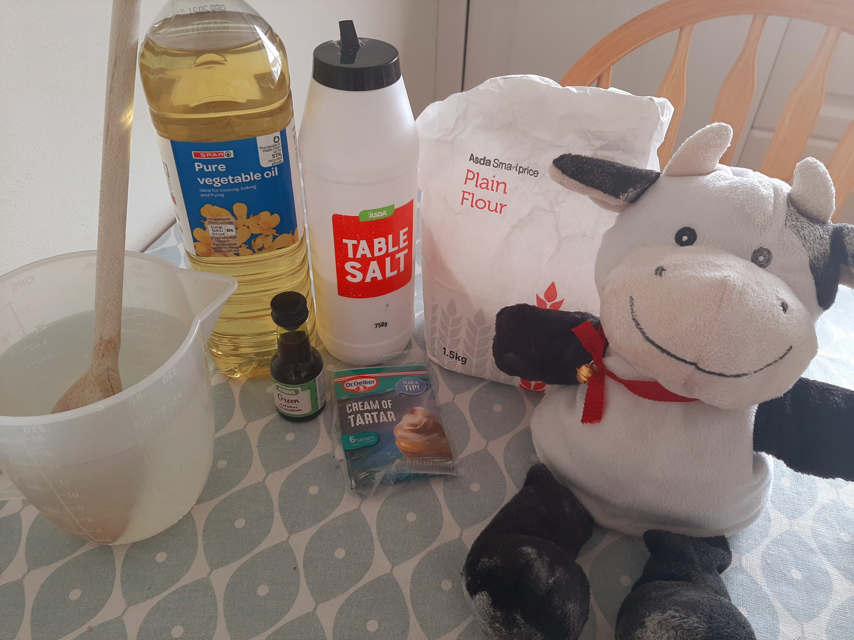
You will need…
2 cups plain flour
2 tablespoons vegetable oil (baby oil will work too)
1/2 cup salt.
2 tablespoons cream of tartar.
1 to 1.5 cups boiling water (adding in increments until it feels just right)
food colouring (optional)
…..and an adult to help you with the HOT parts!

Slide 3
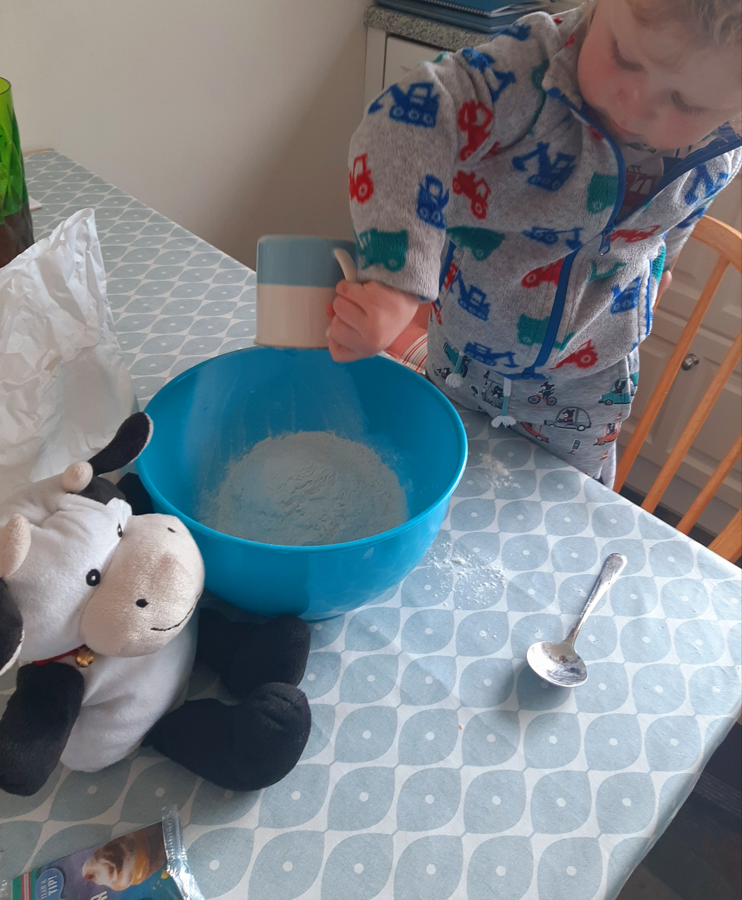
First, put 2 cups of plain flour in a bowl.

Slide 4
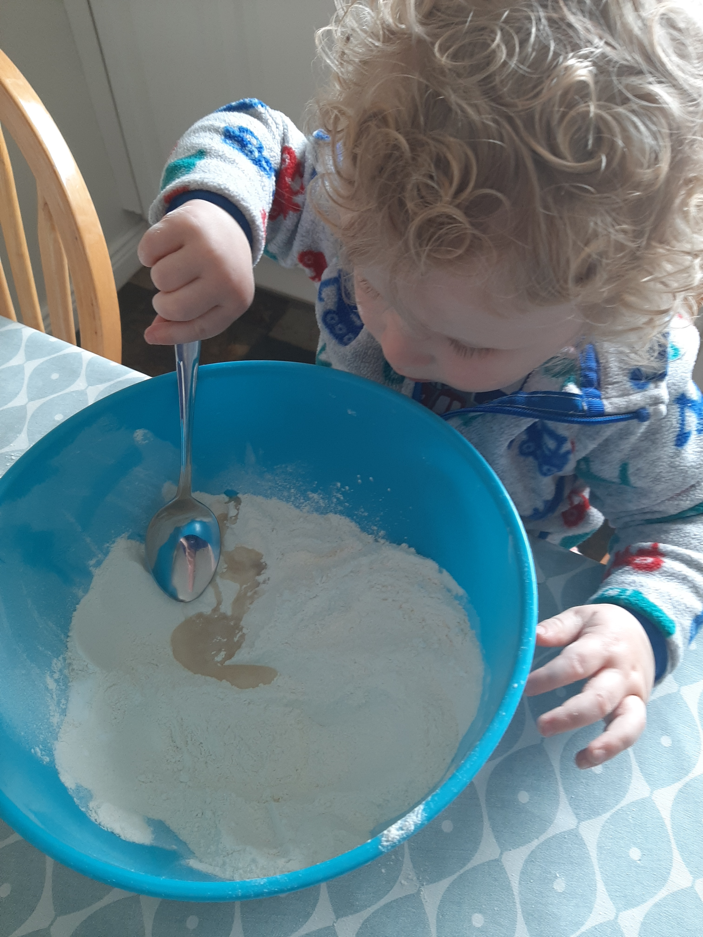
Add 2 tablespoons of oil.

Slide 5
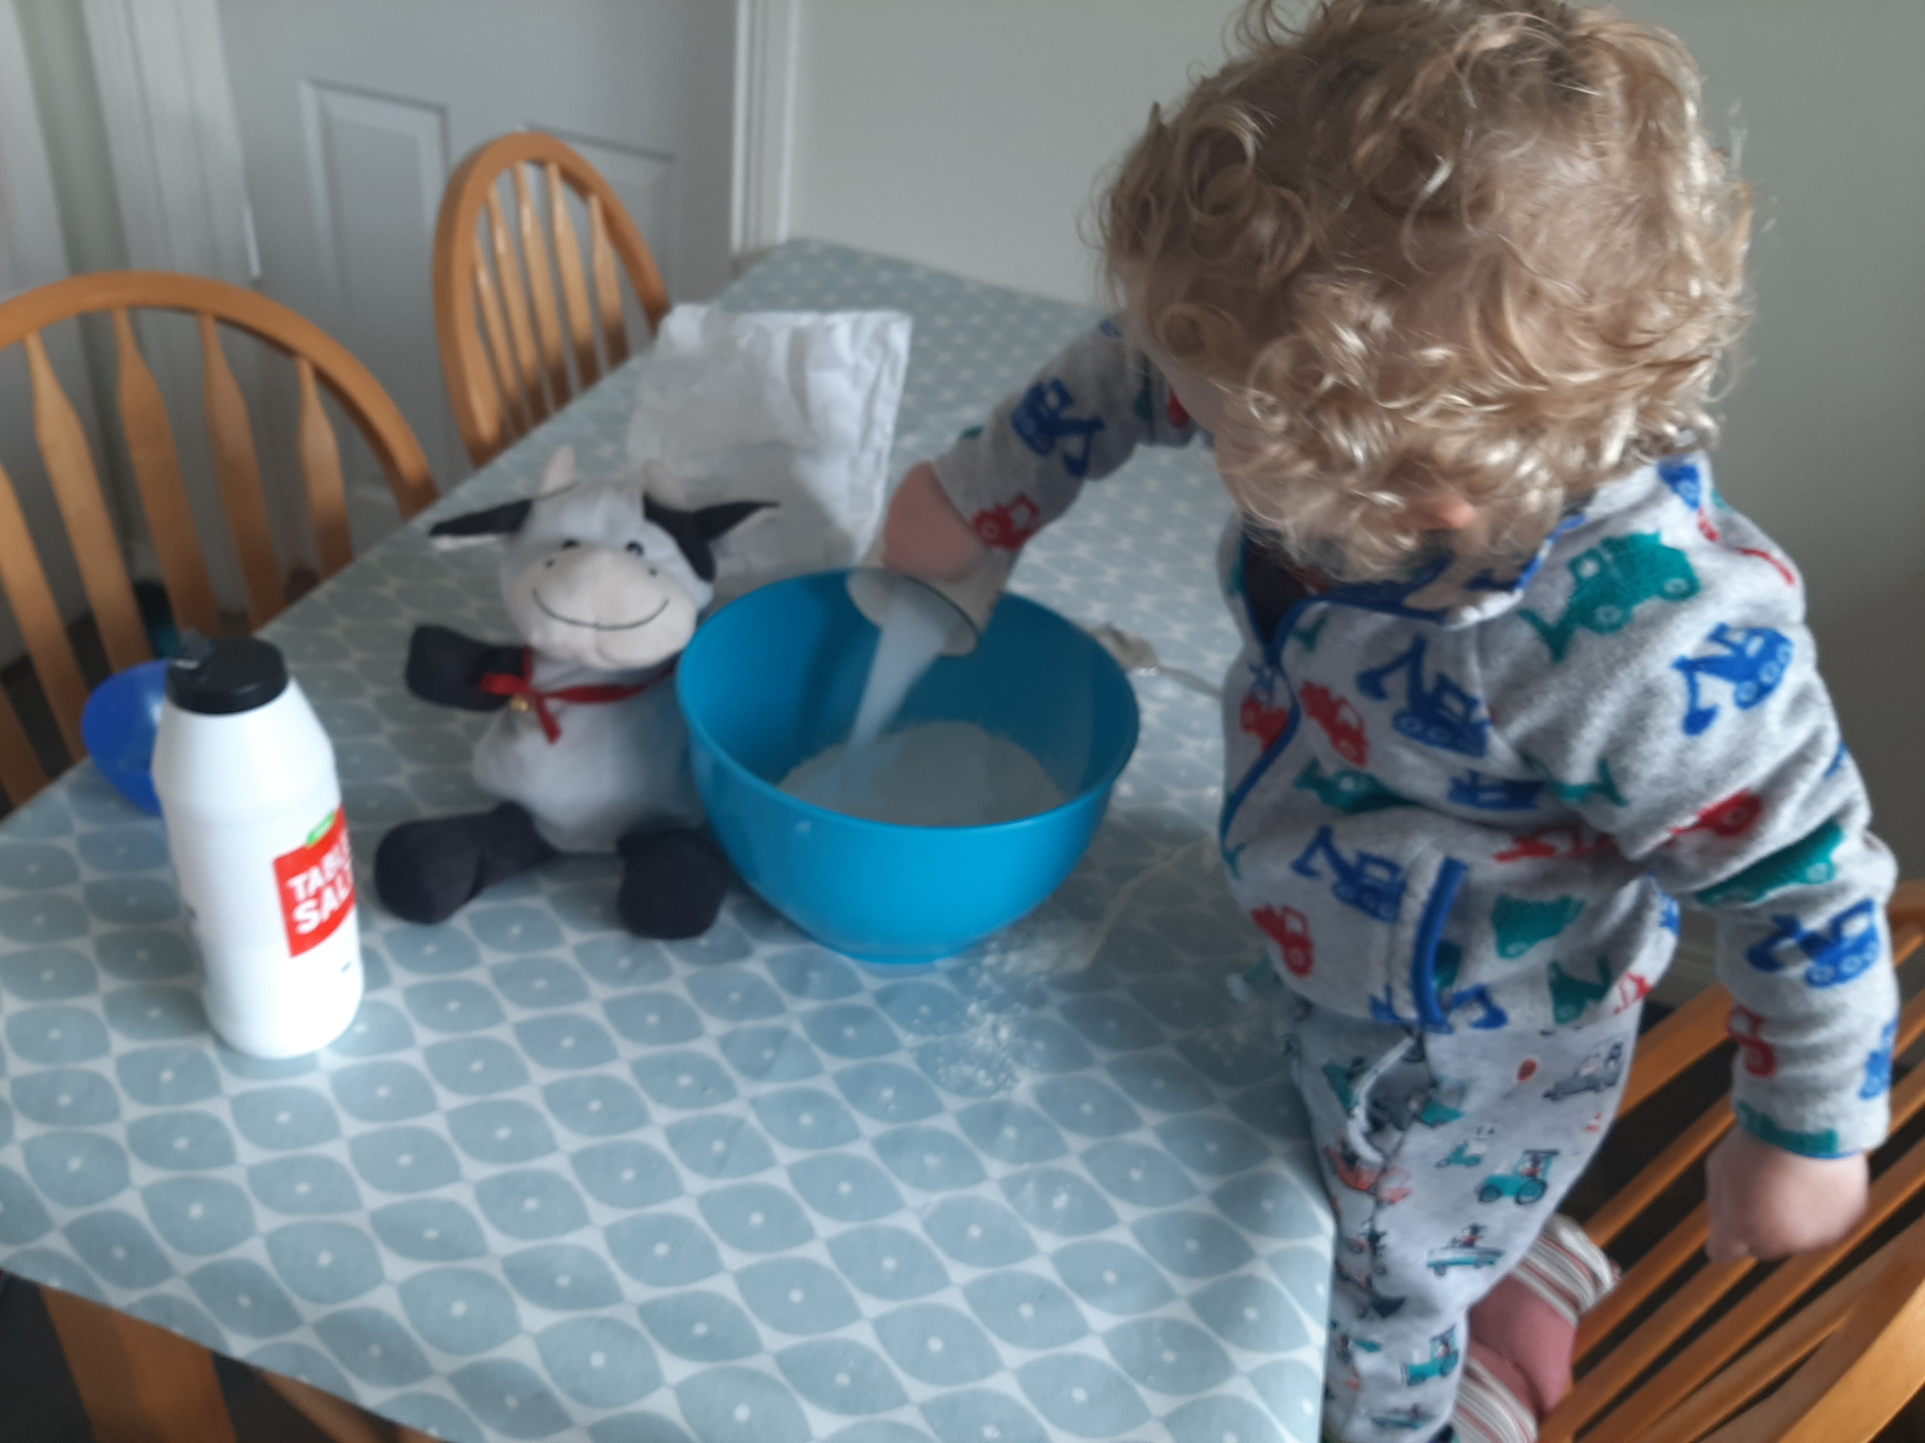
Add a ½ cup of salt.

Slide 6
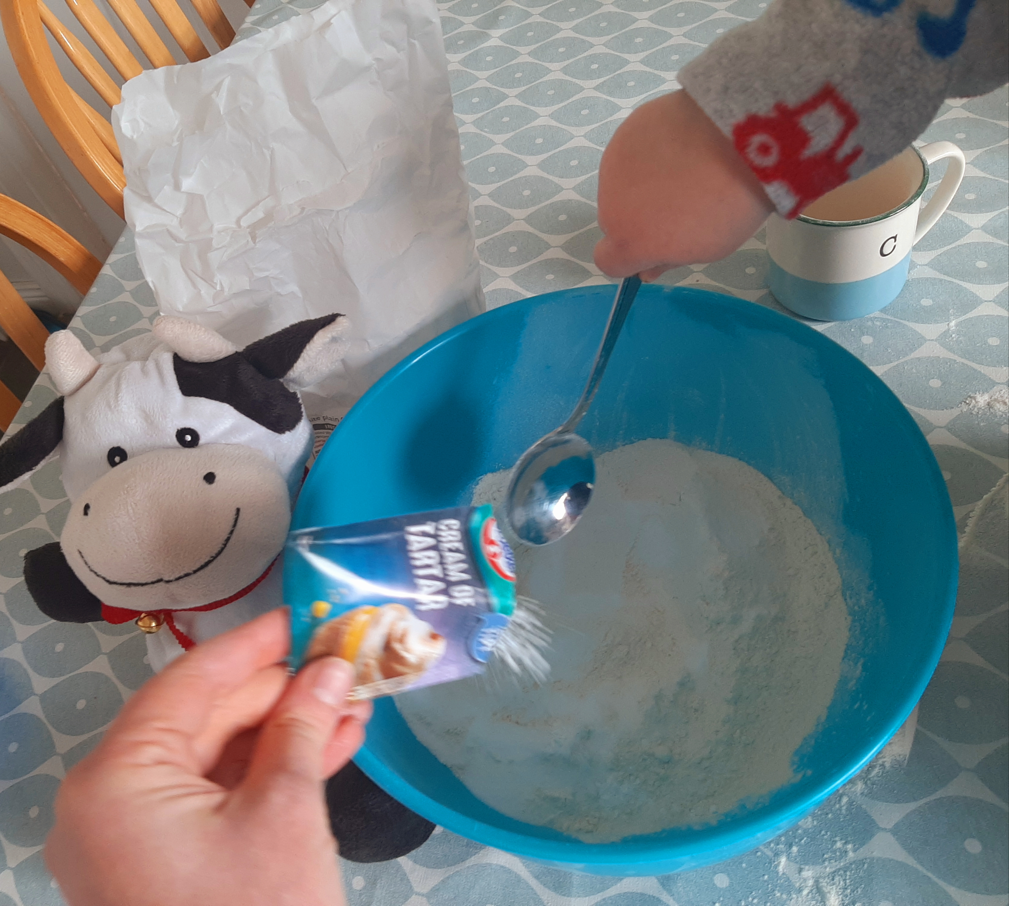
Next, add 2 table spoons of cream of tartar.

Slide 7
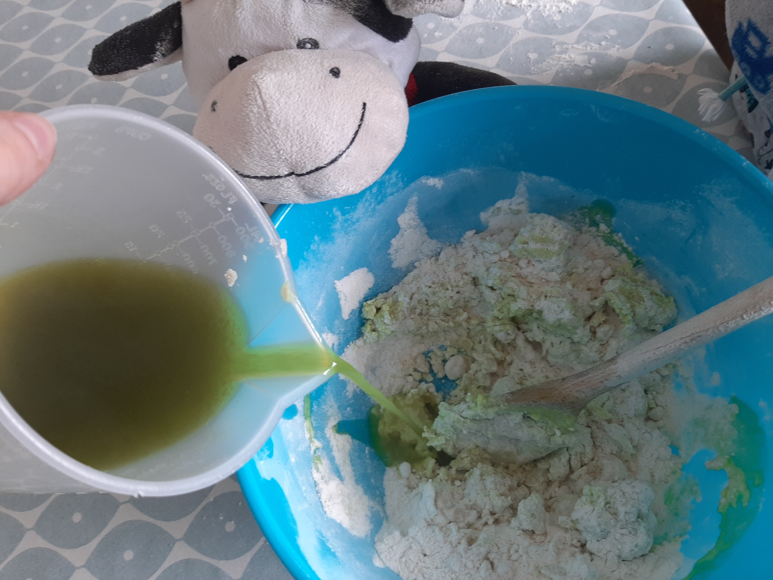
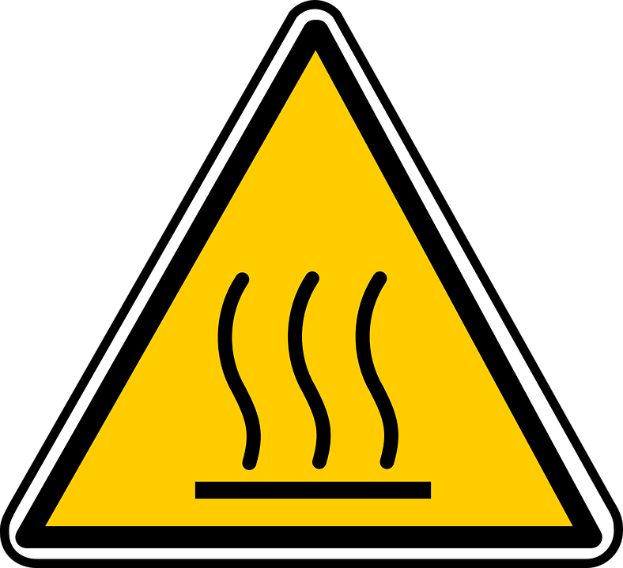
A grown up must do this part. Hot water is DANGEROUS!
Add the food colouring to a cup of hot water.

Slide 8
Pour the water in a little at a time and mix well.
Keep stirring until the mixture becomes sticky.

Slide 9
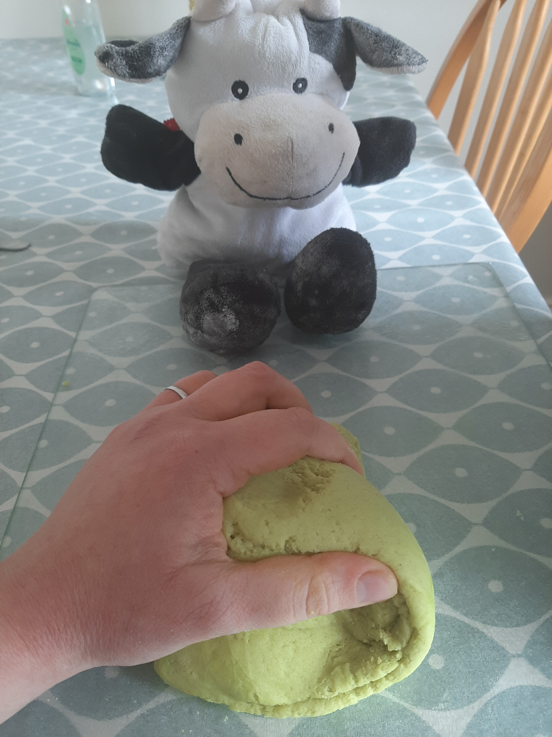
Oh dear! I am covered in flour!
Allow the dough to cool down. Then take the dough out of the bowl and knead it until it feels perfect.

Slide 10
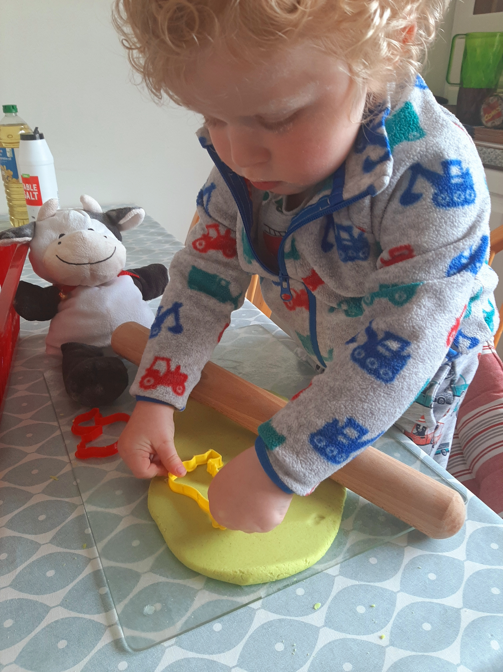
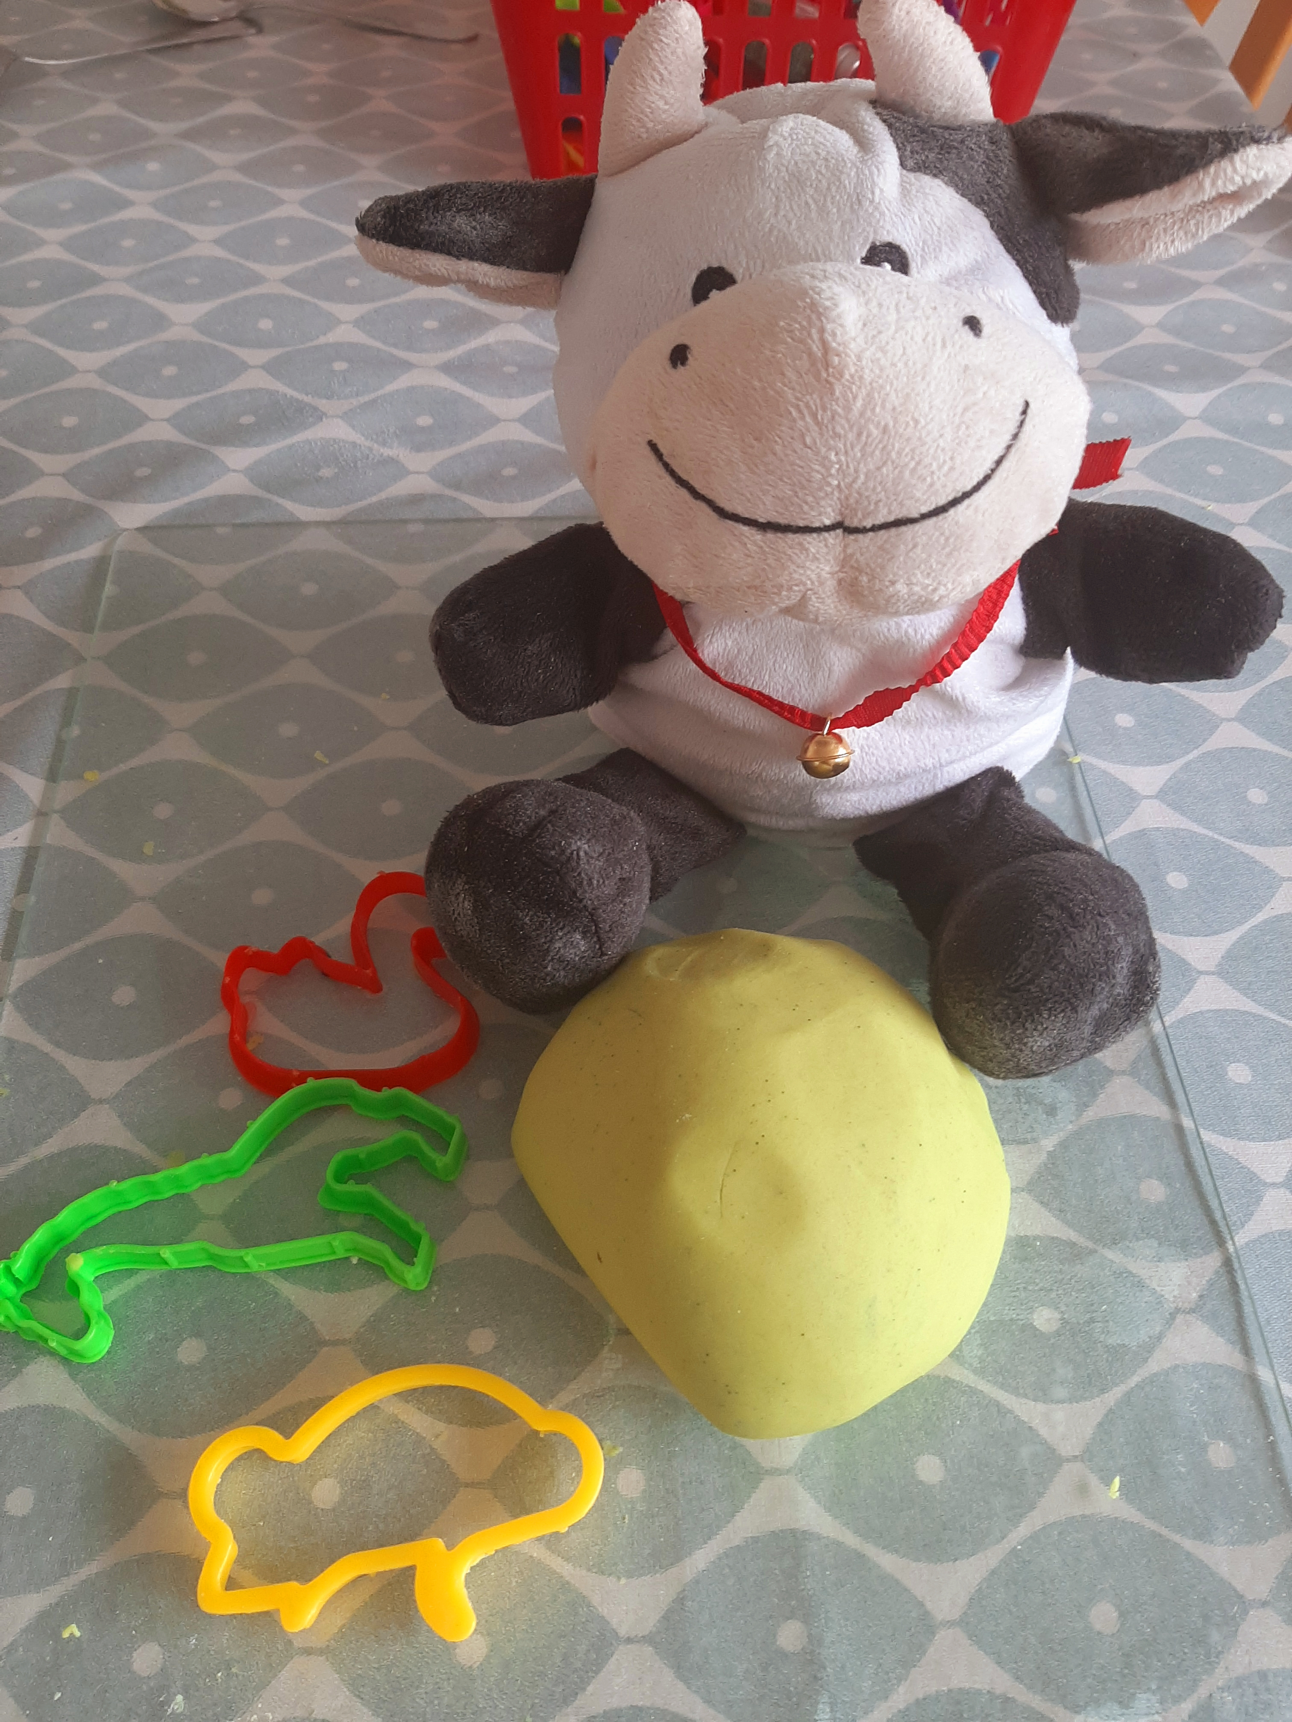
Now your dough is ready to play with!
Store your playdough in an air tight container to use time and time again!

Slide 11
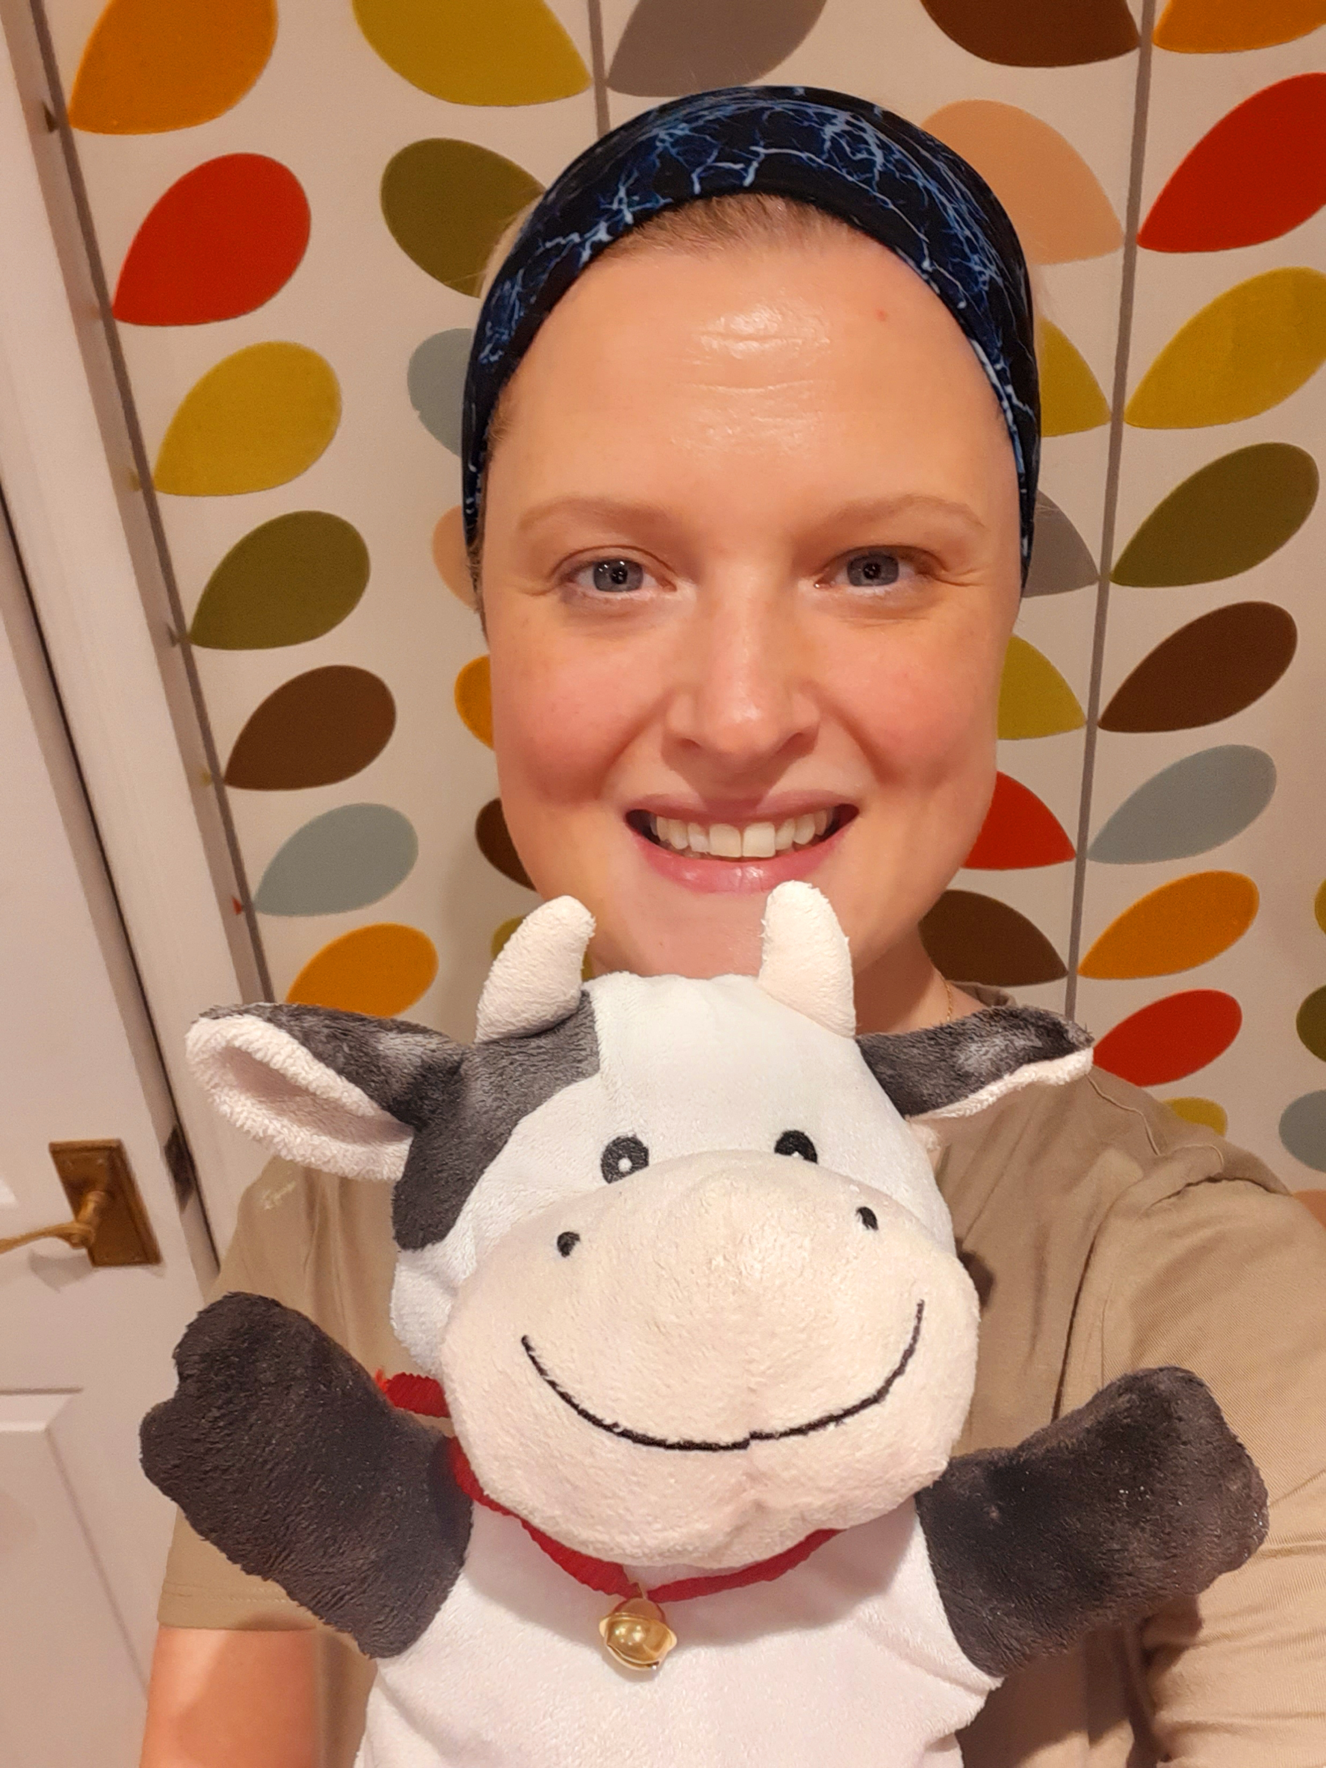
Bye for now,
Missing you all,
Daisy and Teacher.

